Slide 1

KNOWLEDGE INSTITUTE OF TECHNOLOGY
RECRUITING ASSISTANT FOR THE HR MANAGERS
Presented by
JAGADESH S (611220104059)
JAGAN S (611220104060)
MADHESWARAN V L (611220104080)
NAVAJEEVAN S R (611220104093)
GOPAL S (611220104306)
UNDER THE GUIDANCE OF
Mr. R. SIVAGURU ( CSE )
ASSISTANT PROFESSOR,
DEPARTMENT OF COMPUTER SCIENCE AND ENGINEERING

Slide 2
RECRUITING ASSISTANT FOR HR MANAGERS
I.INTRODUCTION
OVERVIEW:
In this project, we use custom objects, relationships, page layouts to give the HR team easy access to data they need on an existing recruitment app. To make the existing app more efficient for the HR team we create custom objects and relationships to store and access the data more efficiently. We install an unmanaged package in the org to get metadata that acts as existing data in the recruitment app.
PURPOSE:
Recruitment apps help you inform candidates of things they need to follow before coming for their interviews. These apps notify them of the documents they need to carry and their timing. Recruitment apps even explain the interview process to them, it does all the simple tasks for you.

Slide 3
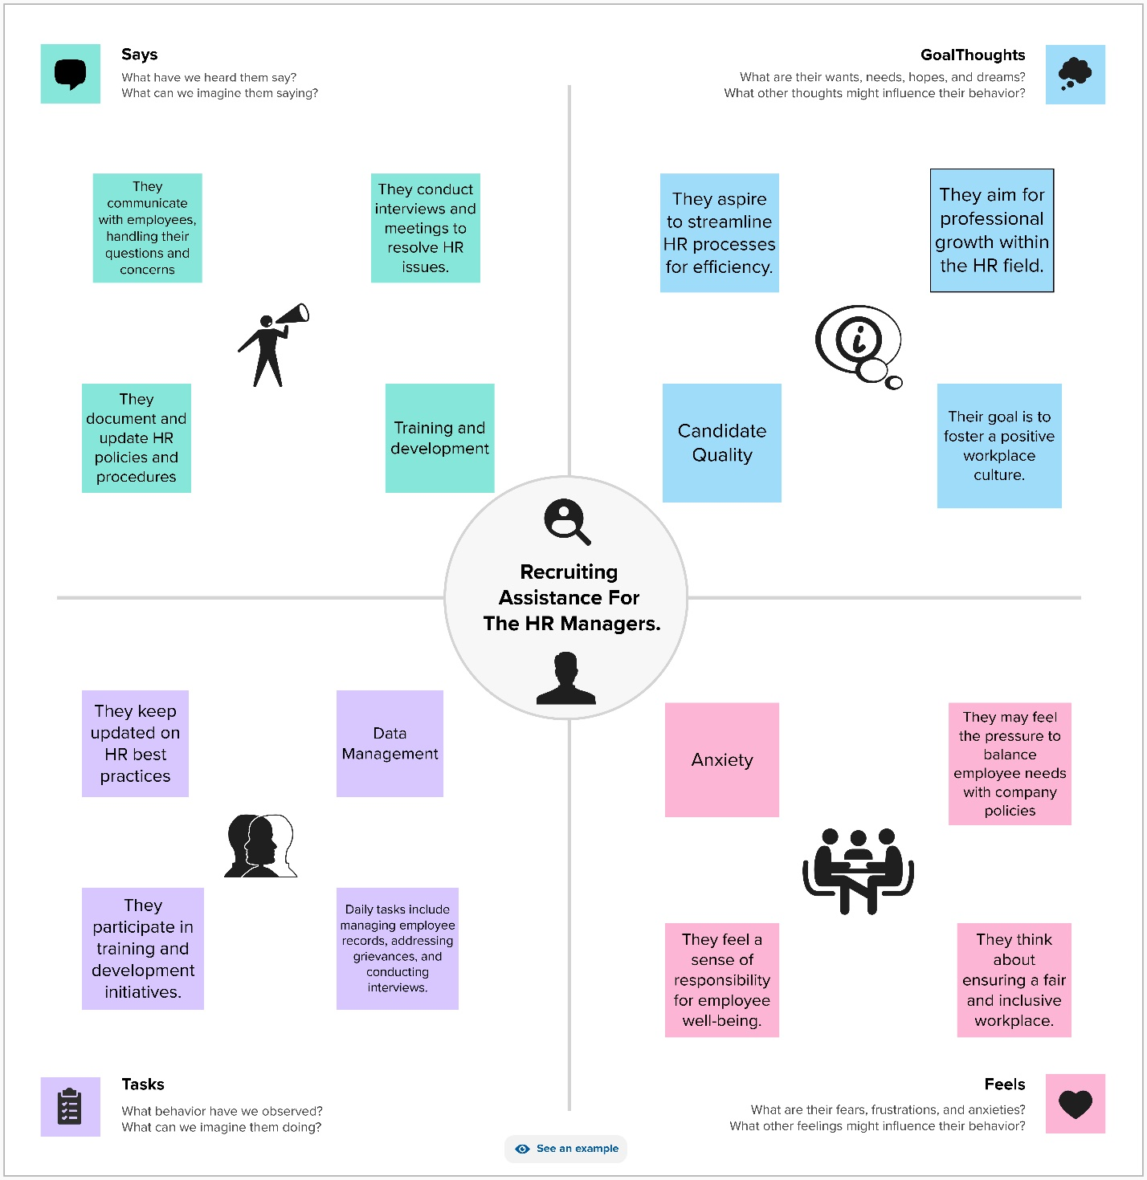
II.PROBLEM DEFINITION & DESIGN THINKING EMPATHY MAP

Slide 4
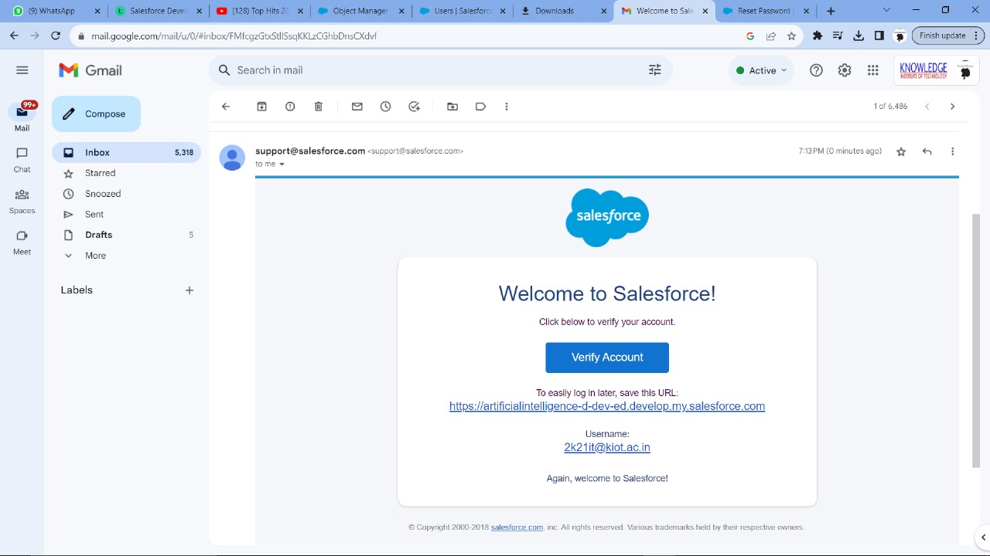
III.ACTIVITY & SCREENSHOT
I. Created a salesforce developer Org through the website developer.salesforce.com and the setup page appeared.

Slide 5
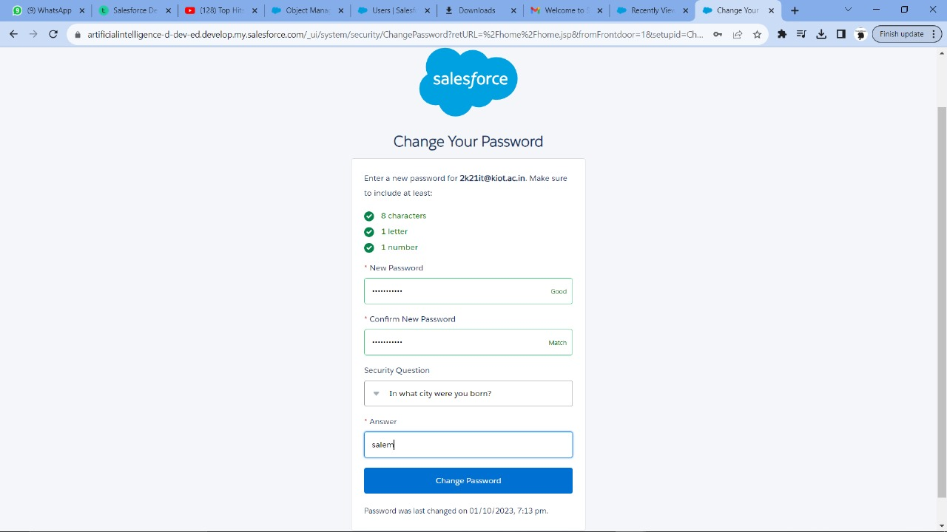

Slide 6
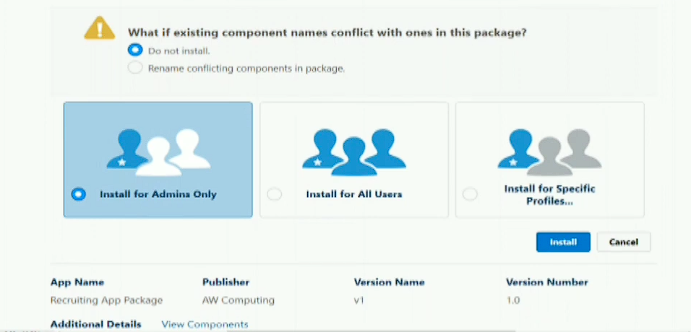
2. Package installation for Recruiting App By clicking the app launcher, Recruiting App was Installed.

Slide 7
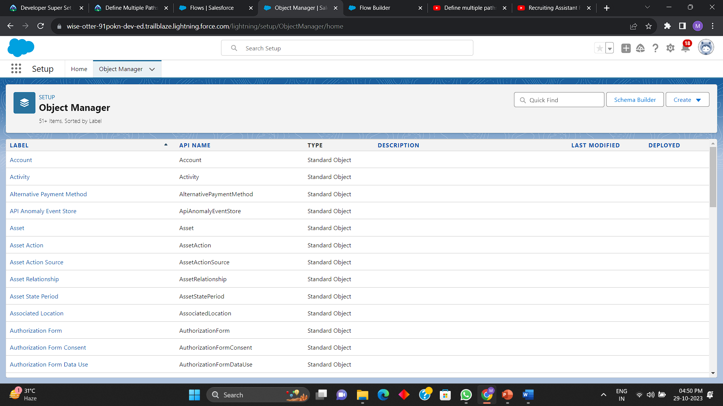
3. To Create a custom object for Job Posting Sites.

Slide 8
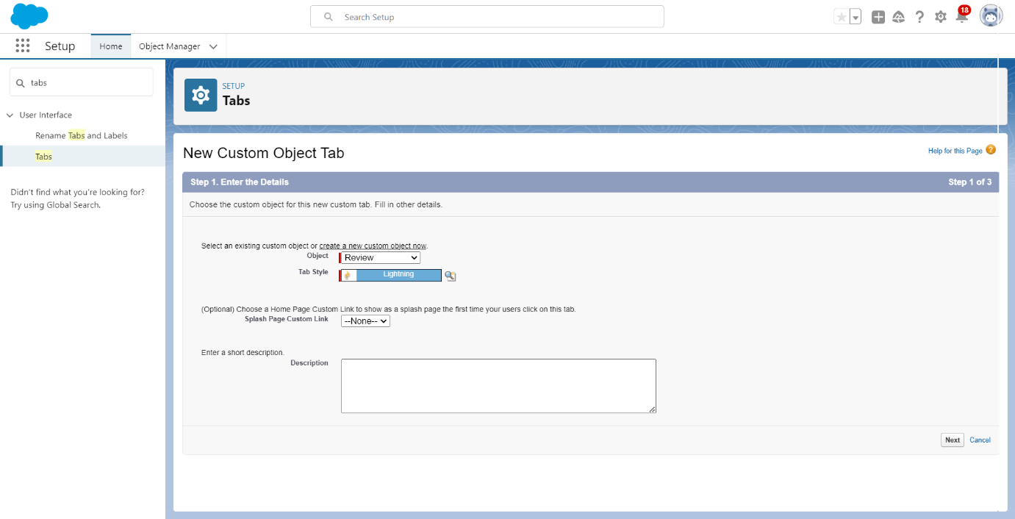
To Create a custom object for reviews.

Slide 9

4. To Create Tab.

Slide 10
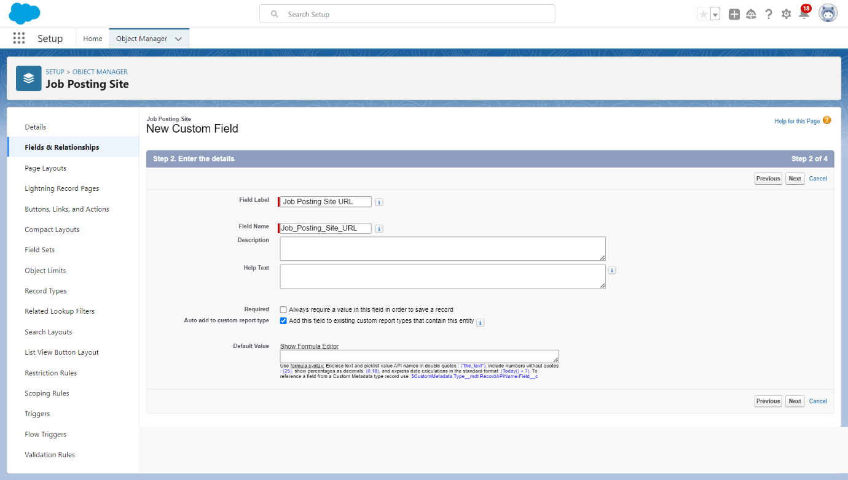
5. Create New Field for Job Posting site.

Slide 11
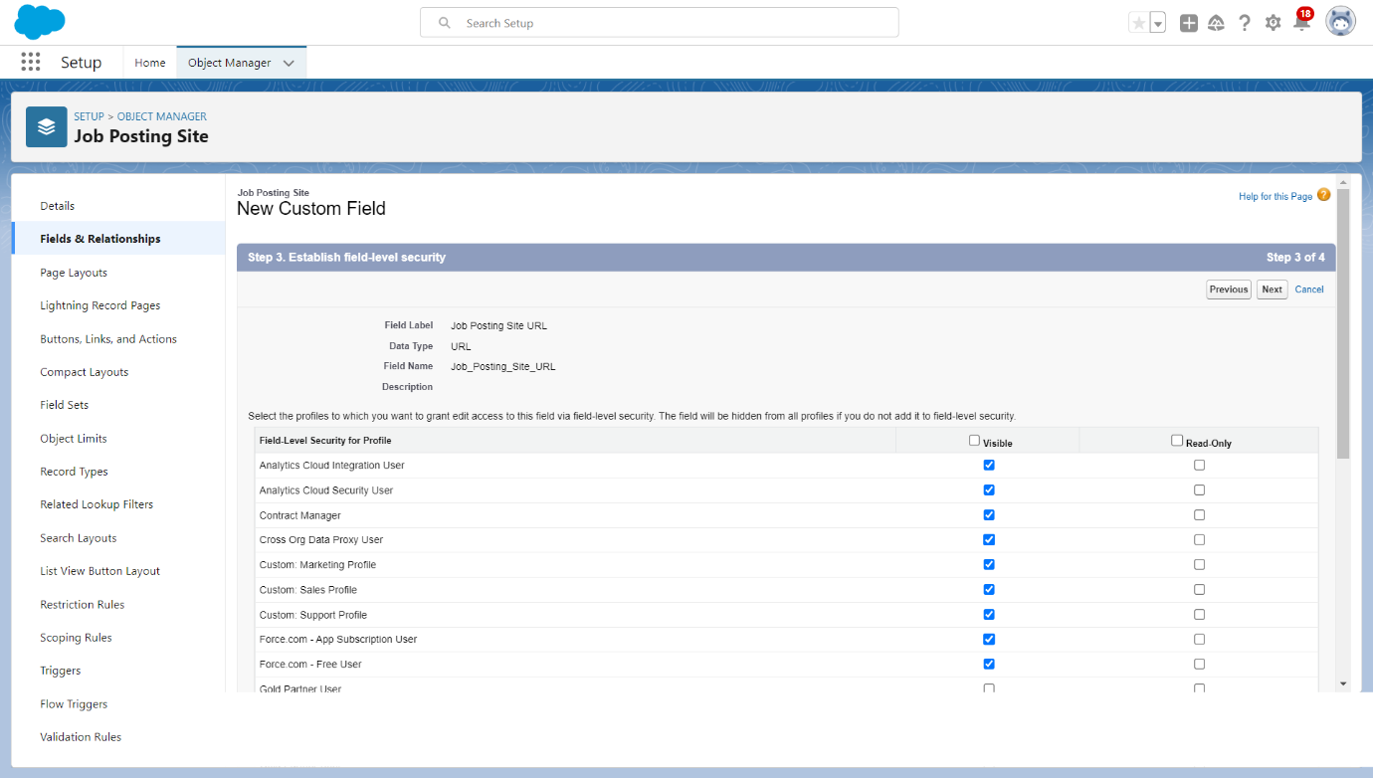
Also Create the Fields for Job Posting site 1. Status 2. Technical site 3. Description

Slide 12
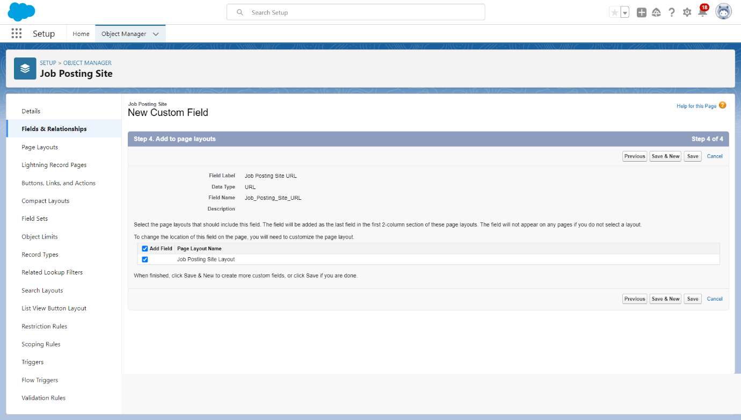

Slide 13
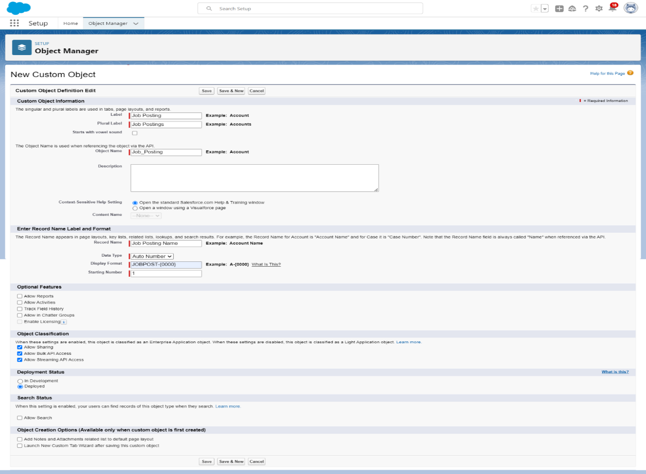
6. Creating a custom junction object for Job Posting.

Slide 14
7. Creating a master-detail relationship between Job posting and job posting site.

Slide 15
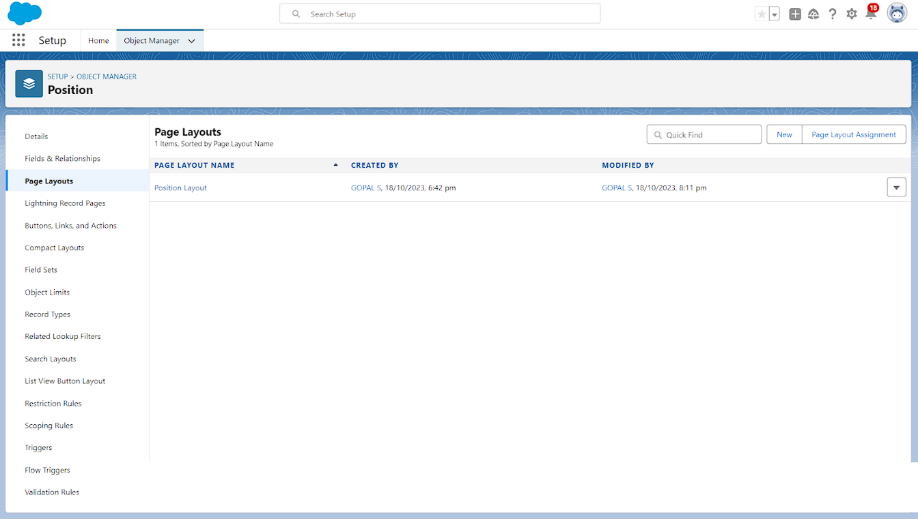
8. To Modify the page layouts

Slide 16
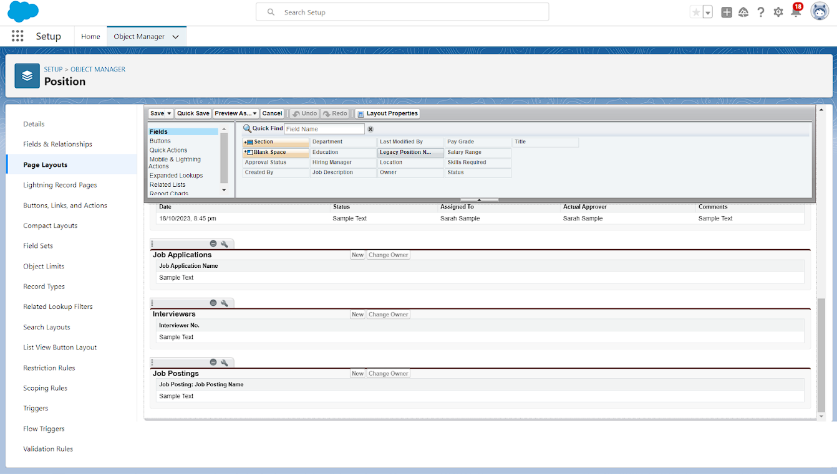
9. Create a Page layout for Review Object

Slide 17
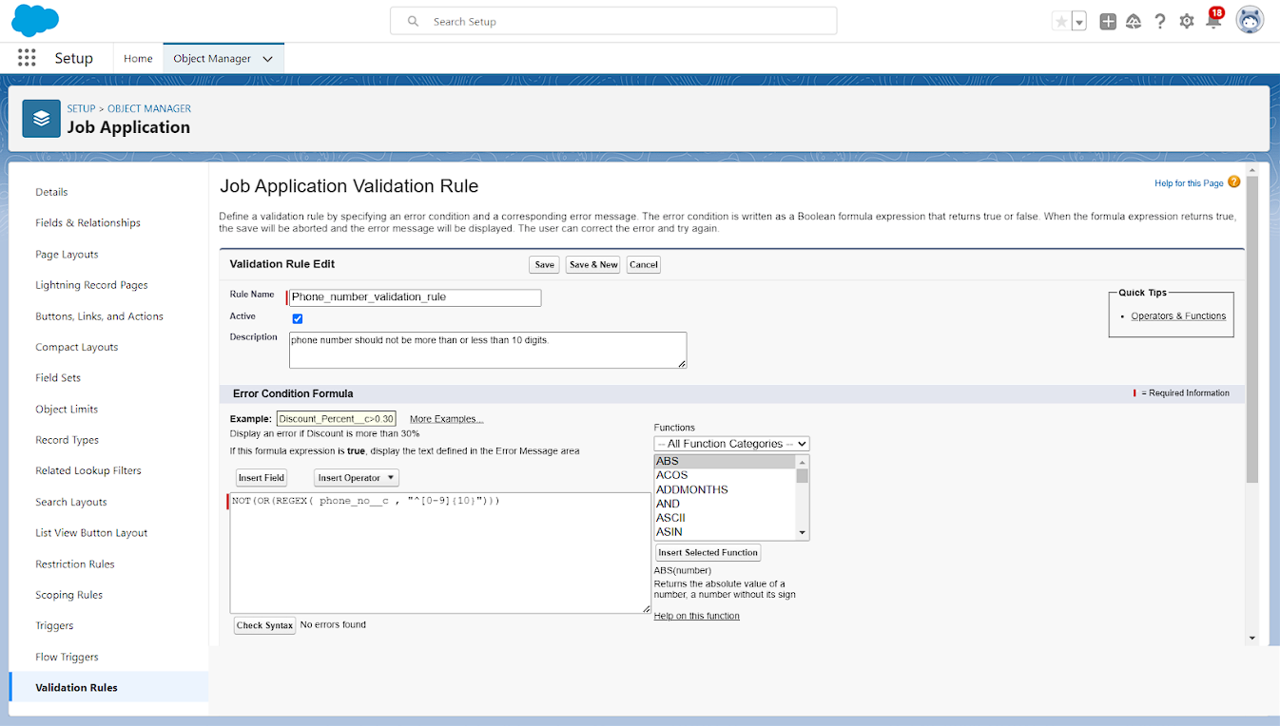
10. To create a validation rule.

Slide 18
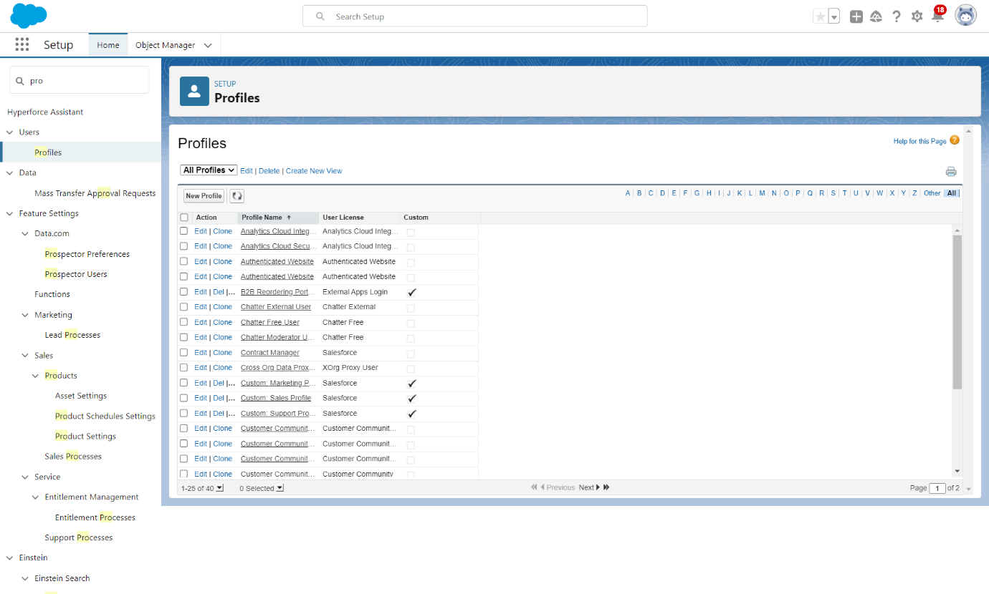
11. Creation on Profile

Slide 19
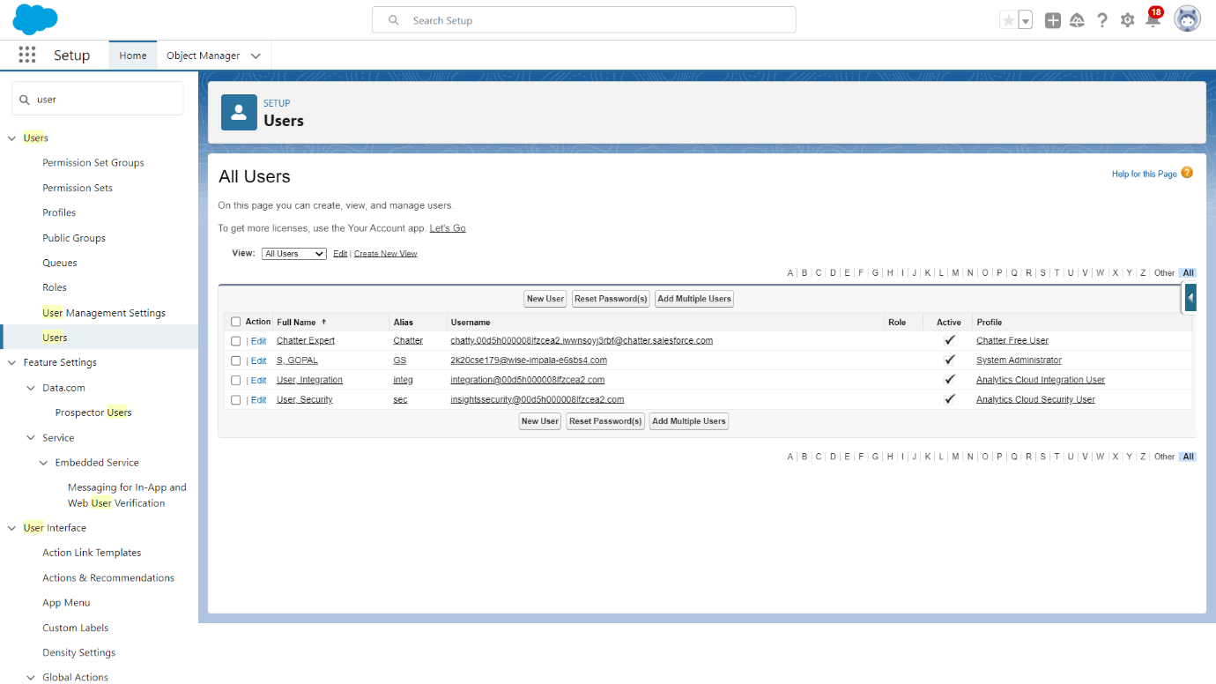
12. User

Slide 20
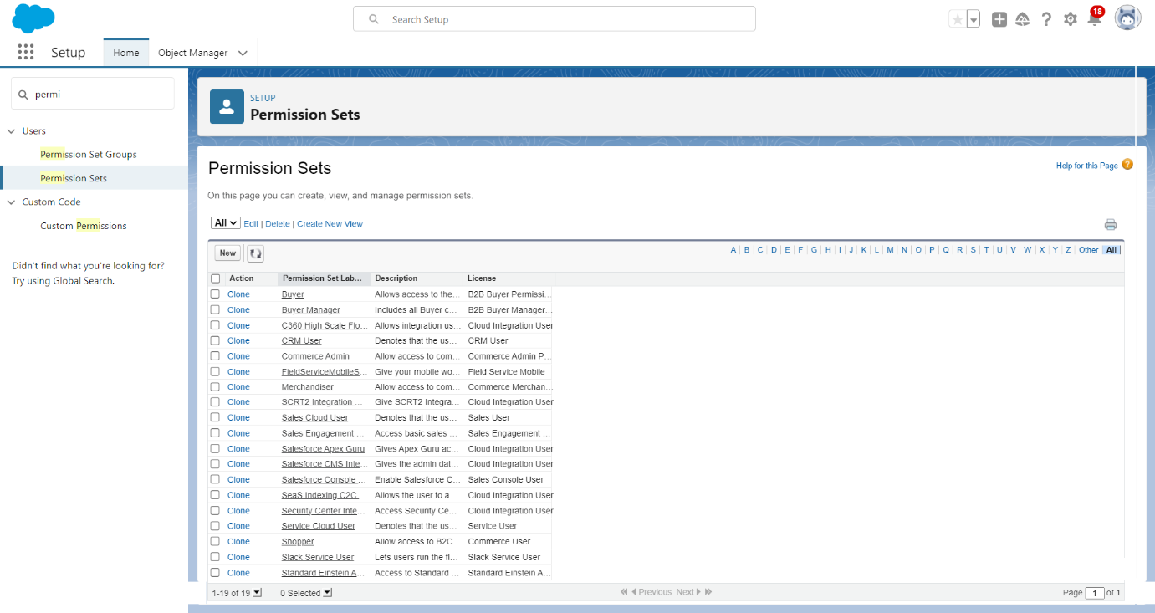
13. Creating a Permission set

Slide 21
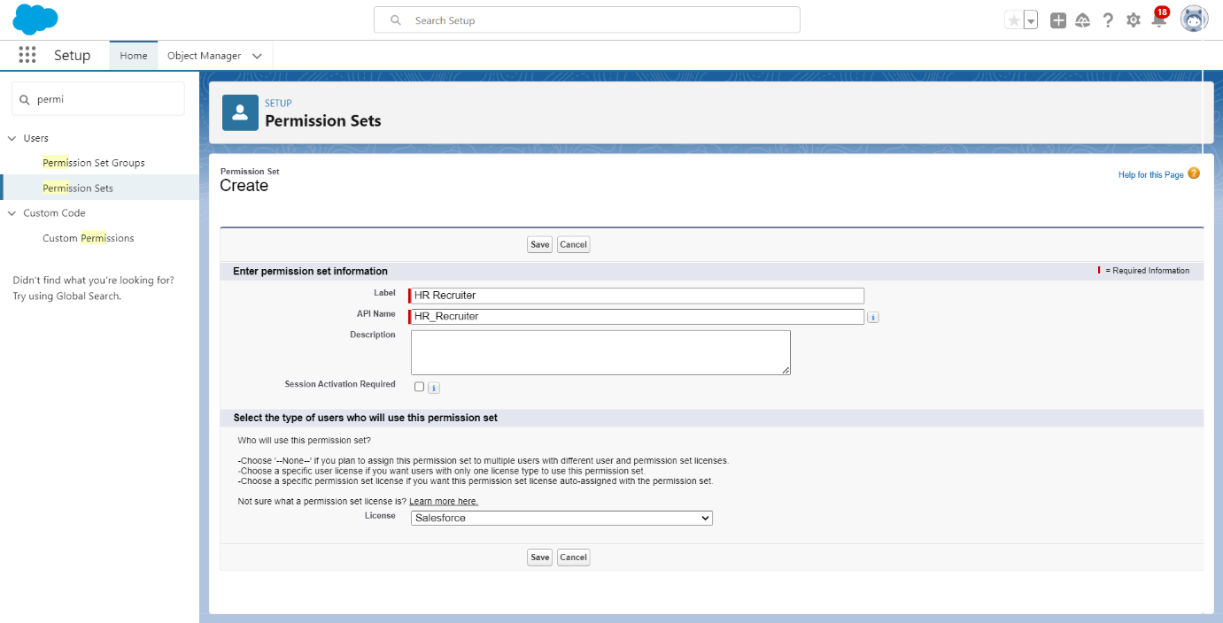

Slide 22
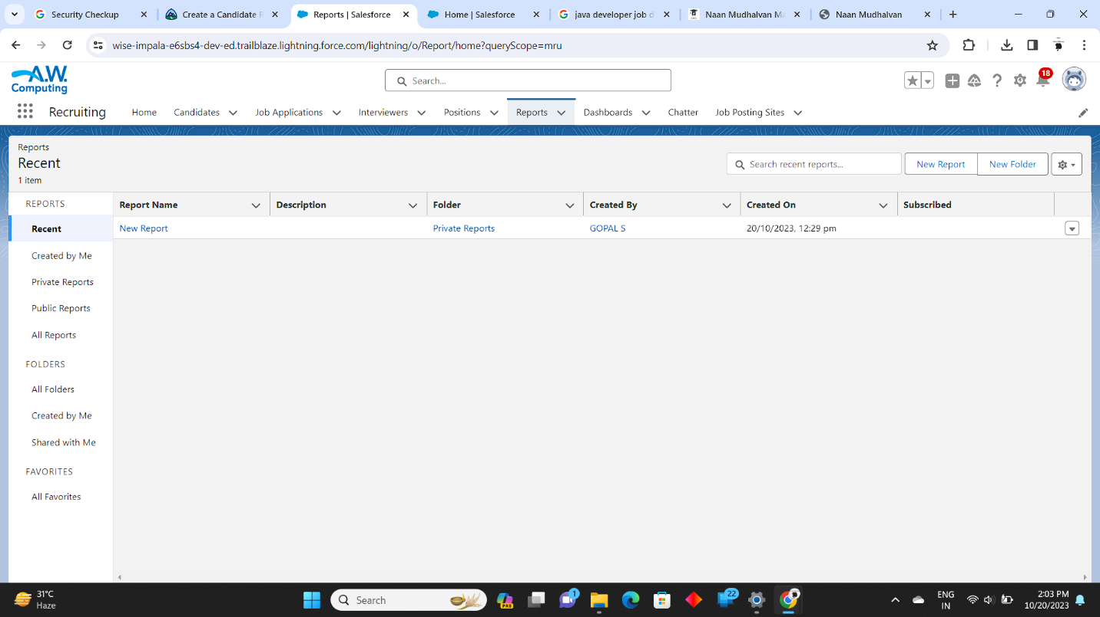
14. Creation of REPORT

Slide 23
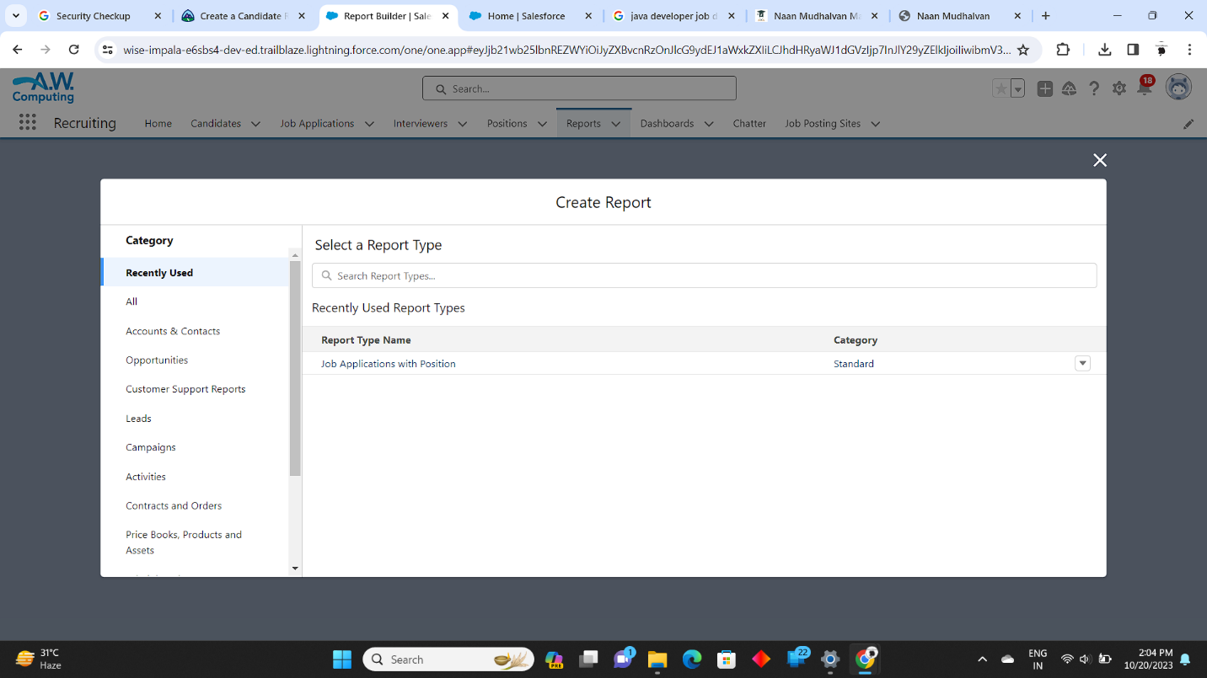

Slide 24
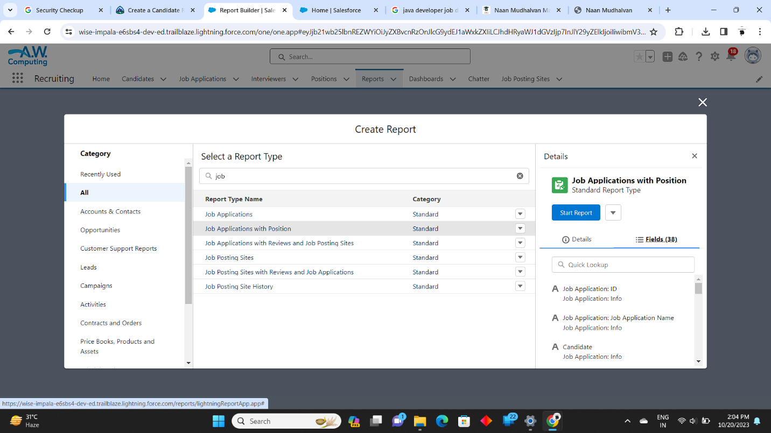

Slide 25
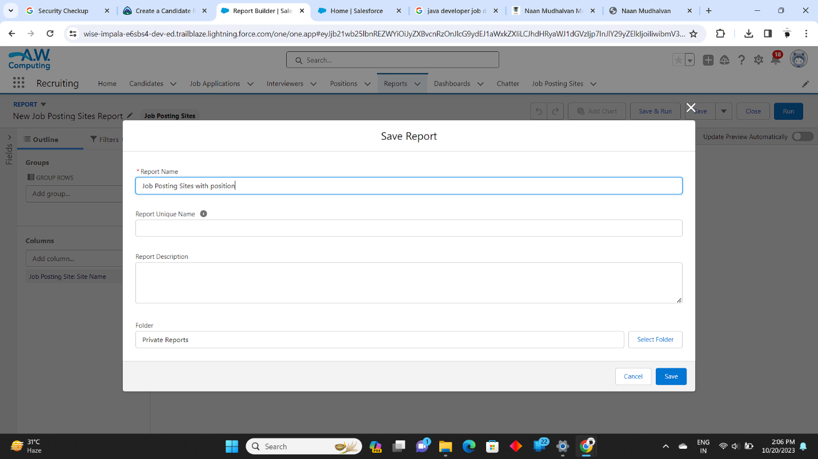

Slide 26
IV. ADVANTAGES & DISADVANTAGES
ADVANTAGES:
Help manage job trainings where employees can learn transferable skills.
As an HR assistant, you might help provide employees with performance reviews that offer valuable information about their work.
This allows them to identify areas of improvement in their skills and knowledge.

Slide 27
DISADVANTAGES(CHALLENGES):
Attracting top talent, Talent acquisition is a top priority for HR given the competitive nature of the current market.
Change management
Reskilling and upskilling
Building digital dexterity
Managing diversity
Employee engagement
Employee retention
Leadership development

Slide 28
V. FUTURE SCOPE
A human resources (HR) assistant is a certified professional who handles the daily administrative and HR duties of an organization.
They assist HR managers with recruitment record maintenance, and payroll processing, and provide clerical support to all employees.

Slide 29
VI. Trailhead Profile Public URL Team Member 1 :https://www.salesforce.com/trailblazer/jaga1117 Team Member 2 : https://www.salesforce.com/trailblazer/jagas25 Team Member 3 : https://www.salesforce.com/trailblazer/madheswaranvl0619 Team Member 4 : https://www.salesforce.com/trailblazer/navsr4 Team Member 5 : https://www.salesforce.com/trailblazer/krishnaaro

Slide 30
THANK YOU

